Slide 1


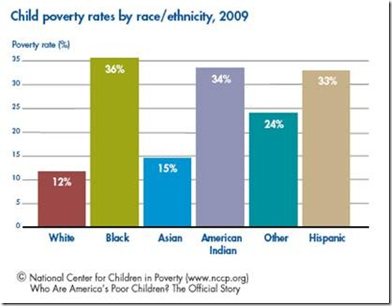

FROM UNDP
CHILD POVERTY

Slide 2
CHILD POVERTY
PAGE 02
Definition
Child poverty can be defined as the condition of children from poor families (and often orphans) growing up with scarce or non-existent resources.
Causes of Child Poverty
POOR AND UNEMPLOYED PARENTS
LACK OF EDUCATION
LACK OF SOCIAL SERVICES
DISABILITY
DISCRIMINATION
POOR AND UNEMPLOYED PARENTS
Children living in poverty are very often born to parents living in poverty, creating a cycle.
High child mortality rates, lack of education, forced marriage and to support the wider family.

Slide 3
CHILD POVERTY
PAGE 03
LACK OF EDUCATION
When children are born to poor parents, they have less access to schooling and education.
Especially in agricultural communities, they often end up helping the family with agricultural work, thus entering a vicious circle where they can never develop their educational skills to give them possibilities for greater earnings in the future.
LACK OF SOCIAL SERVICES
Many developing countries do not have well-established social support services for poor children and their families.
They are forced to rely on themselves, their extended families and their communities for any economic support they might receive

Slide 4
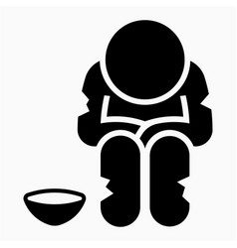
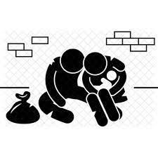
CHILD POVERTY
PAGE 04
DISABILITY
Disabled people in poor communities in developing countries could be described as being the ‘poorest of the poor’, having to deal with physical disabilities on top of difficult economic circumstances.
So disabled children can really have the hardest lives of all.
DISCRIMINATION
If children and their families have the additional complication of being discriminated against for their gender, religion, ethnicity, social class or political allegiance.
This is another factor that can increase the cycle of poverty.

Slide 5
CHILD POVERTY
PAGE 05
To Solve Child Poverty
Child poverty needs to be tackled at multiple hierarchy levels - from individuals, local communities, families and schools up to local and national governments and global institutions such as the World Bank and the International Monetary Fund.
As individuals we can feel powerless to make a difference against what seem like overwhelming statistics, but many charities run hugely successful programs which make real impacts on the lives of children living in poverty.
PROVIDING EDUCATION
Education is perhaps the most effective strategy to tackle poverty and is integrally linked to human, community and national development.
Children who have the opportunity to learn are able to eventually earn more money and support their own families.

Slide 6
CHILD POVERTY
PAGE 06
FEEDING A YOUNG MIND
Feeding a young mind is literally true. Hunger keeps children out of school and limits their ability to concentrate once there.
Conversely, a school breakfast or lunch program will be an important incentive to attract children to attend school.
When you feed a child, you make it possible for him or her to learn. And when you make it possible for her to learn, you make it possible for him/her to feed herself and her family for years.
EMPHASIS ON GOVERNMENT
Our support for government efforts are guided by our Social Protection Strategy, which promotes child-sensitive social protection that is led by governments and integrated across sectors, including health, nutrition and education..
The Strategy aims to tackle the many challenges faced by vulnerable children, which are rarely limited to lack of income.

Slide 7
CHILD POVERTY
PAGE 07
MAJOR INITIATIVES
This work improves the lives of children in two ways. First, we promote social assistance benefits that can increase living standards and reduce child poverty, focusing on outreach to ensure that the most marginalized and vulnerable people are able to access the benefits to which they are entitled.
Second, we promote social transfer systems that dovetail with other services to ensure that marginalized children and adolescents have access to health care ,education, job training and HIV/AIDS programmes .
AN EXAMPLE
In Georgia, for example, our work with the Government and the World Bank has supported a major increase in social benefits for children.
Georgia introduced a child benefit in 2015, which reached more than 153,000 children under the age of 16 in 2016.

